Slide 1
Uber Data Analysis

Slide 2
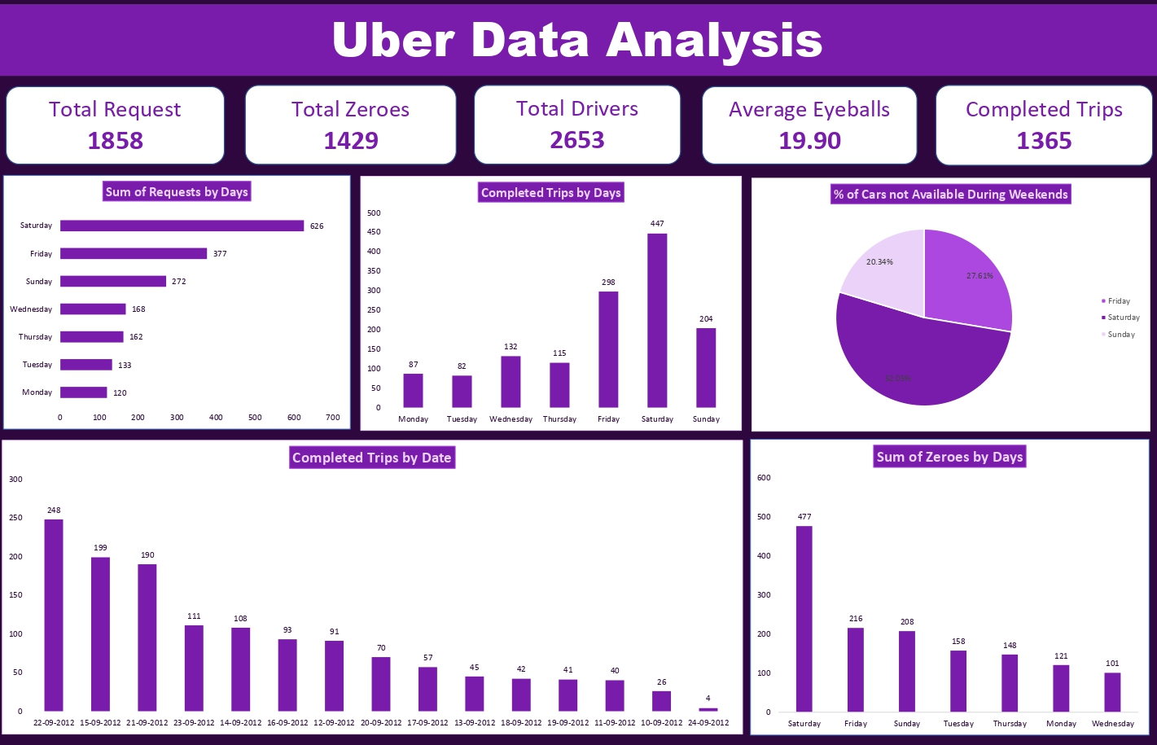
Contents of this template
You can delete this slide when you’re done editing the presentation
Fonts | To view this template correctly in PowerPoint, download and install the fonts we used
Used and alternative resources | An assortment of graphic resources that are suitable for use in this presentation
Thanks slide | You must keep it so that proper credits for our design are given
Colors | All the colors used in this presentation
Icons and infographic resources | These can be used in the template, and their size and color can be edited
Editable presentation theme | You can edit the master slides easily. For more info, click here
For More Info: Slidesgo | Blog | FAQs
You Can Visit Our Sister Projects: Freepik | Flaticon | Storyset | Wepik | Videvo

Slide 3
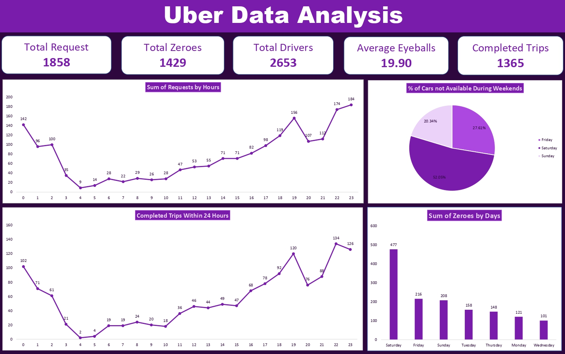
Contents of this template
You can delete this slide when you’re done editing the presentation
Fonts | To view this template correctly in PowerPoint, download and install the fonts we used
Used and alternative resources | An assortment of graphic resources that are suitable for use in this presentation
Thanks slide | You must keep it so that proper credits for our design are given
Colors | All the colors used in this presentation
Icons and infographic resources | These can be used in the template, and their size and color can be edited
Editable presentation theme | You can edit the master slides easily. For more info, click here
For More Info: Slidesgo | Blog | FAQs
You Can Visit Our Sister Projects: Freepik | Flaticon | Storyset | Wepik | Videvo

Slide 4
Table of contents
01
02
03
04
05
06
Problem Statement
Methodology
Goals & KPI
Key Insights
Recommended Analysis
Conclusion

Slide 5
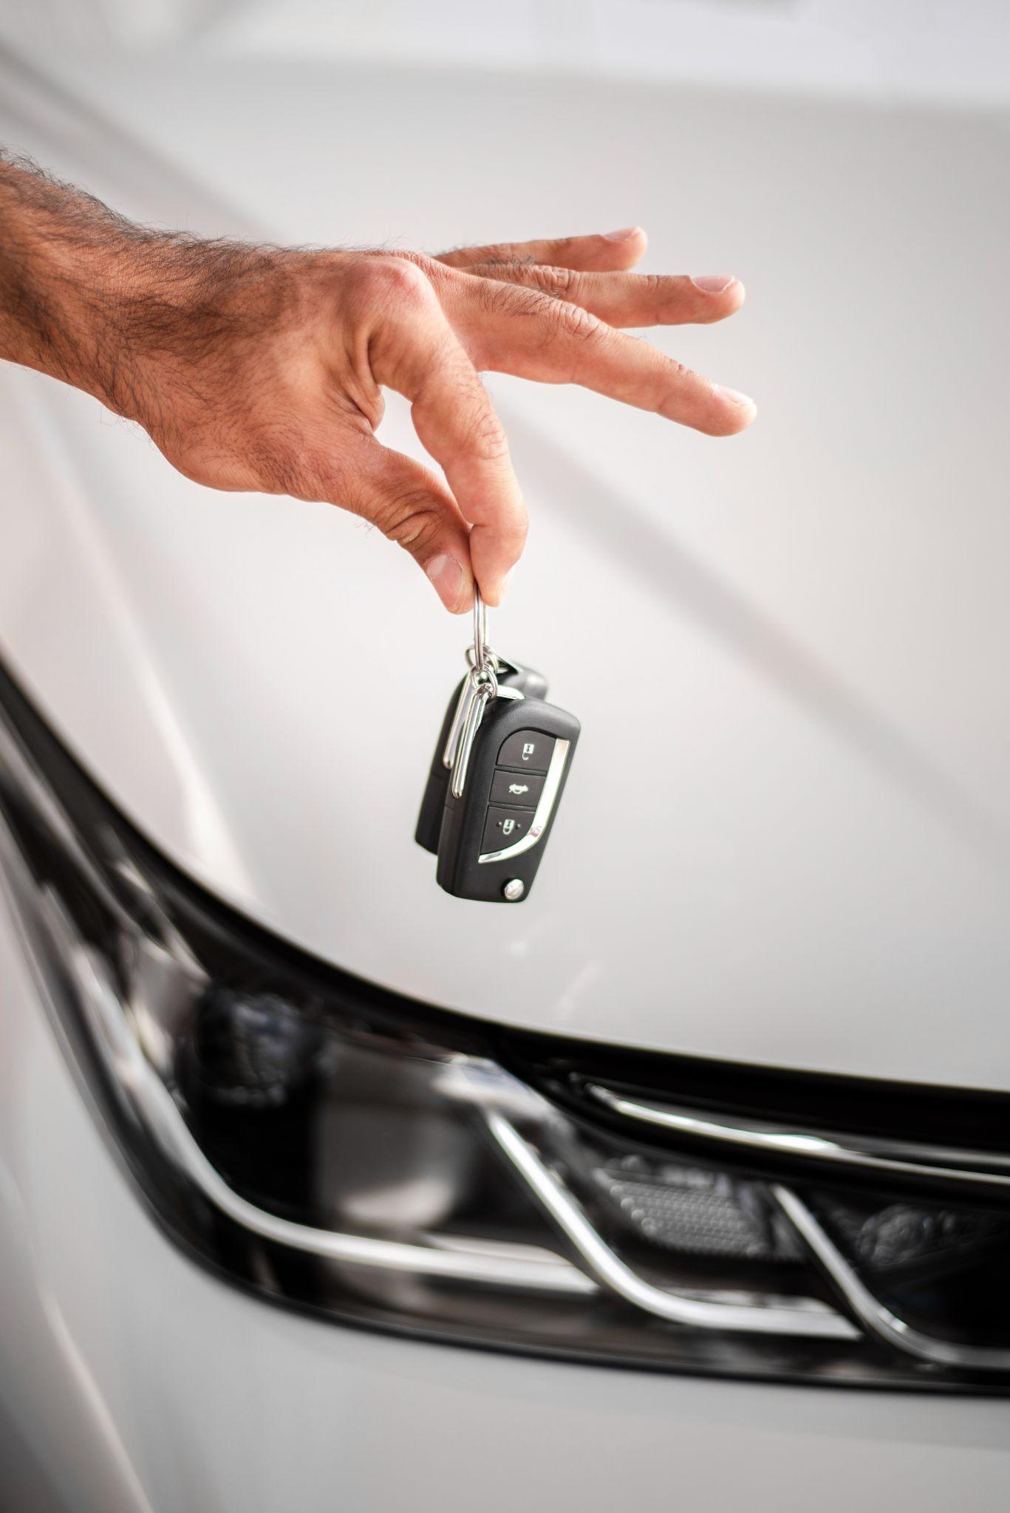
Problem & Background
The ride-hailing market often faces a gap between customer demand and the availability of drivers, resulting in missed opportunities and customer dissatisfaction. This project utilizes 2016 data from DailyUber to analyze Uber's request data and identify insights that can optimize driver allocation and improve customer experience.

Slide 6
Methodology
Data Collection
Data Cleaning and Preprocessing
Exploratory Data Analysis (EDA)
Demand and Supply Gap Analysis
Insights Extraction
Recommendations
Reporting
Validation

Slide 7
Goals
Analyze Demand Patterns Investigate how ride requests change over time to identify peak demand periods and influencing factors.
Evaluate Supply Levels Assess driver availability against customer requests to find times of potential driver shortages.
Measure Customer Experience Understand rider satisfaction by analyzing metrics like app openings and instances of zero available cars.
Optimize Resource Allocation Recommend strategies to align driver availability with demand to improve response times and service efficiency.
Identify Improvement Areas Highlight operational challenges and propose recommendations to enhance service quality and effectiveness.

Slide 8
Key Performance indicator(KPI)
1429
1858
Total Zeroes
Total Request
1365
2653
Completed Trips
Total Drivers

Slide 9
Key Insights
High Demand on Weekends: Saturdays see the highest percentage of customers (52.05%) unable to secure rides, indicating a significant supply-demand gap.
Friday and Sunday Trends: Fridays and Sundays also face availability issues, with 27.61% and 20.34% of customers, respectively, unable to find cars.
Ride availability drops significantly on weekends, especially on Saturdays. Increasing driver supply during these peak times can bridge the gap and improve customer satisfaction.

Slide 10
Conclusion
This Uber data analysis reveals a significant supply-demand imbalance, particularly on weekends. The highest unmet demand occurs on Saturdays, where more than half of customers experience no available cars. Fridays and Sundays also show noticeable gaps in availability. Addressing this by increasing driver supply during peak times can improve service efficiency, reduce customer frustration, and enhance the overall user experience. By understanding these demand patterns, Uber can optimize operations and meet rider needs more effectively.

Slide 11
Thanks!

